Slide 1



A COMPUTATIONAL MODEL OF COLLABORATIVE NEGOTIATION BASED ON THE INTERPERSONAL RELATION OF DOMINANCE
Presented by :
Lydia OULD OUALI (LIMSI-CNRS / UPSUD)
Directors :
Nicolas Sabouret (LIMSI-CNRS / UPSUD)
Charles Rich (CS / WPI)
Notes:
En accortd avec mes encadrants,
Pk tu parles français alors que les slides sont en anglais

Slide 2
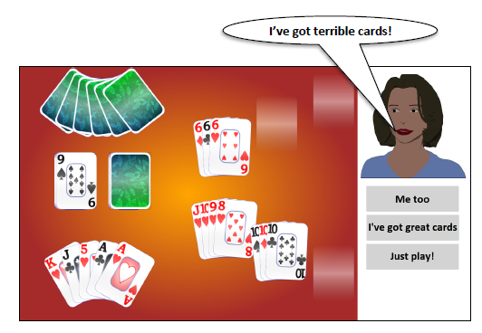
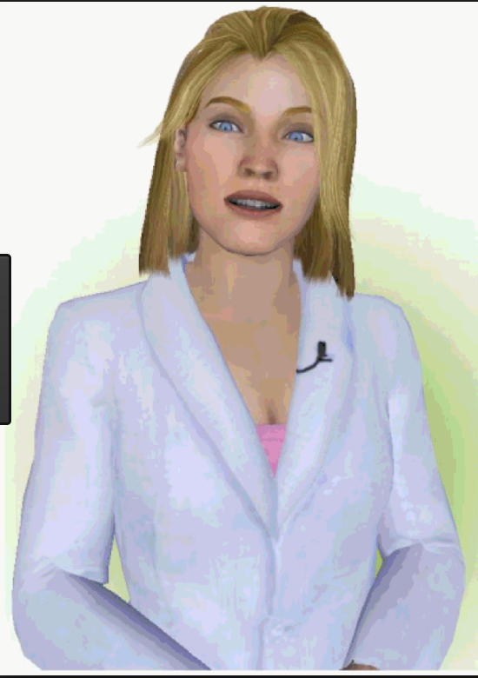

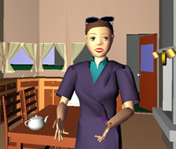
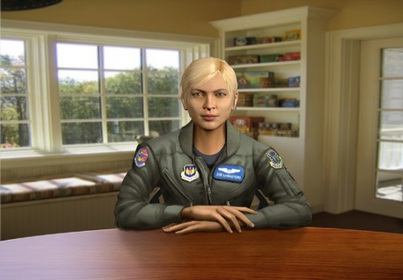


Context: conversational agents
AlwaysOn
Sidner et al, 14
Smith et al, 10
Companion
Partner
Tardis
Sabouret et al, 15
REA
Bickmore et al, 02
SimCoach
Rizzo et al, 11
Tutor
ACA
Louise
Davi
…
SimSensei
DeVault et al, 14
Notes:
Nous assistons, donc, à l’émergence croissante d’agents conversationnels sociaux dans des domaines d’applications variés. Ces agents jouent différents rôles allant de compagnon artificiel [92, 95], patient virtuel [61, 66] ou tuteur pour le e-learning [62, 63].

Slide 3
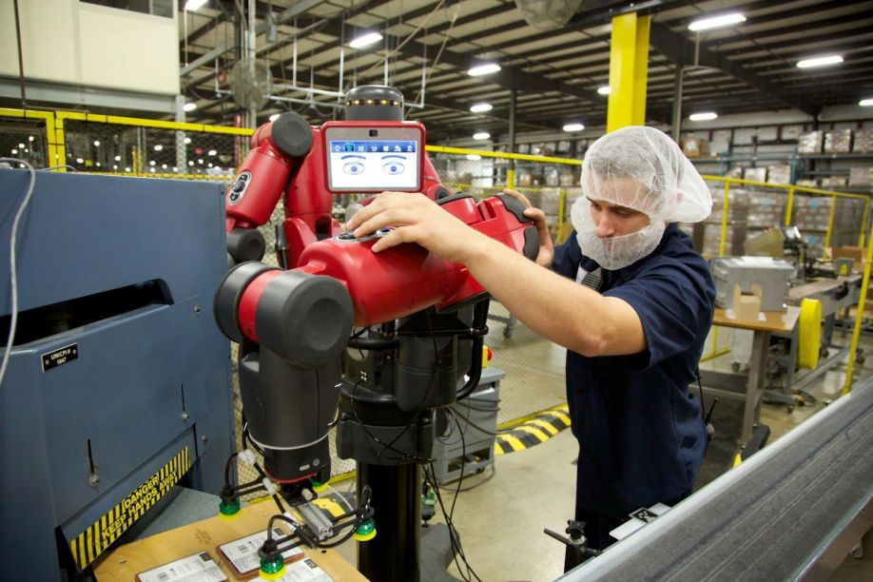
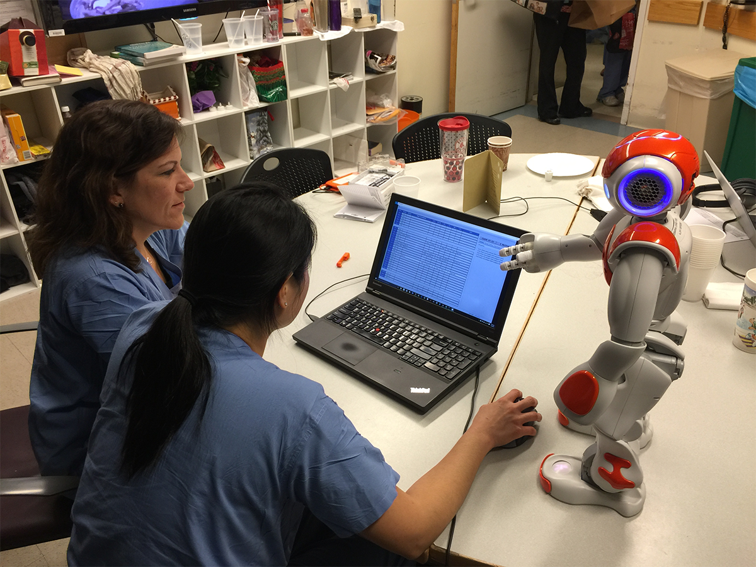
Context: conversational agents
COLLABORATIVE NEGOTIATION
(Lewicki et al 11 , Wollkind et al 04)
Facilitate mutual understanding
Agreement making
TASK ORIENTED
INTERACTION
Generation of new ideas
Rethink robotics
INTERPERSONAL RELATIONSHIP
(Tiedens 03)
Impact of interpersonal relation on the negotiation
Nurses collaborating with MIT Nao Robot
Focus on DOMINANCE
Notes:
Ajouter refs sous images + à droite: 1 ref pour « collab nego » et 1 pour « impact of interpers. On nego »

Slide 4



PROBLEMATIC
Interpersonal relation of DOMINANCE
Decisional model based on behaviors of dominance
COLLABORATIVE
NEGOTIATION

Slide 5
plan
Concept of dominance and state of art
Computational model of collaborative negotiation
Decisional model controlled by dominance behaviors
Study and validation: perception of dominance in negotiation
Analyze of the partner: Model of ToM
Study and validation : complementarity vs similarity
Conclusion and perspectives
1
2
3
4
5
6
7
Notes:
Ne pas lire toutes les parties,
Citez seulement les deux parties avec implementations et simulations

Slide 6
Context: CONCEPT OF DOMINANCE
Social status
Interpersonal relation
DOMINANCE
Personality trait
Notes:
Sur les 3 suivants, positionner les bulles de couleur au bon endroit

Slide 7

Context: CONCEPT OF DOMINANCE
Social status
Interpersonal relation
DOMINANCE
references
Personality trait
Individual trait
Ability to exert power
Want to control others
Desire of celebrity
Notes:
REFERENce

Slide 8
Context: CONCEPT OF DOMINANCE
Social status
Interpersonal relation
DOMINANCE
Personality trait
Position in social hierarchy (Liska, 90)
Legitimate expression of power and dominance
Vested dominance: Birth order, kinship or privileges
e.g: college professor, judge, or corporate president
Earned dominance: Based on relational or social skill
Notes:
. Vested dominance may result from birth order, kinship, or be institutionalized and granted as the rights and privileges of a particular role, e.g., college professor, judge, or corporate president. Vested dominance may also result in physical power dependent upon the physical characteristics of the individual. Size, age, silverbacks, and shoulder hair mantles are all symptoms of physical power. Social dominance, power, and influence, on the other hand, are earned, and dependent upon social strategy selection and enactment abilities, empathic abilities, and the potential for affiliation and engagement of friendship

Slide 9
Context: CONCEPT OF DOMINANCE
Social status
Interpersonal relation
DOMINANCE
Personality trait
Ability to exert power (Burgoon & Dunbar 98)
Power: Ability to influence the behavior of another person (Burgoon et al 98)
Control attempts by one individual are accepted by the interactional partner
(Burgoon & Dunbar 98)

Slide 10

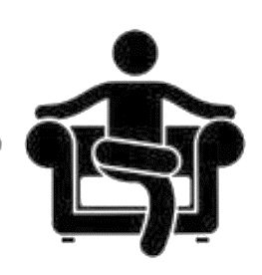

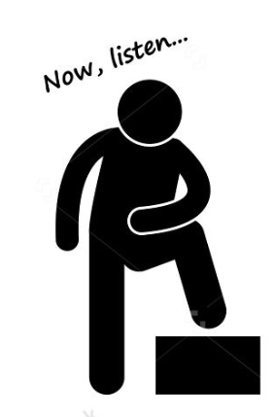


Context: expression of dominance
Verbal behaviors
Non-verbal behaviors
Speech frequency , interruption
kinesic cues (Posture, body movement, gestures, facial expressions)
Communication strategies
Direct strategies
Indirect strategies
Initiate interaction and behaviors
High vocal tone and frequency
Facial expression
Notes:
Références + regrouiper avec t10

Slide 11





Context: expression of dominance
Kinesics cues
Vocal control
Posture, body movement, gestures
Turn taking, interruption, amplitude, disfluencies
(Bee, André et al, 10 ; Lance et Marsella,08 ; Strassmann et al, 16)
(Bee, André et al, 10)
Gaze orientation
visual dominance ratio, gaze
Verbal behaviors
Non
verbal behaviors
(Gebhard et al, 08 ; Bee, André et al, 10)
Dialogue strategies
(Frieze et McHugh)
Date de papiers
Vocal tone and frequency
Direct strategies
Indirect Strategies
(Gebhard et al, 14)
Facial expressions
(Ravanet et al 15)
Notes:
Rajouter une zone 3 pour les comportements stratégique

Slide 12


Context: expression of dominance
Non-verbal behaviors
Verbal behaviors
Strategic behaviors
How dominance influences the negotiation strategy ?
Notes:
Si c’est trop chargé, faire un autre transparent (en tout cas ça manque avant les 3 principes)

Slide 13

Negotiation strategy: Behaviors OF DOMINANCE
BEHAVIOURS OF DOMINANCE IN NEGOTIATION
1
Level of demand and concession (Dedreu et al 95)
Dominance is associated to a high level of demand and a low level of concessions
SUBMISSIVE
2
Self vs other (Fiske 93, DeDreu et al 95)
DOMINANT
Dominant individuals are self-centered and only interested in satisfying their own preferences.
3
Lead of the negotiation (Dedreu,VanKleef, 04)
Dominant individuals tends to make the first move
Control of the flow of the negotiation
Notes:
La personne exprimant le … est perçue comme dominante

Slide 14
Model of collaborative negotiation: decision based on behavior of dominance
Implementation of principles of dominance behaviros
in a conversational agent

Slide 15
OVERVIEW OF THE MODEL OF NEGOTIATION
1
Mental model
Mental model
3
Pow
Pow
Preferences
Pow
Preferences
2
Model of the other
Decisional model
Decisional model
Mental model
Adaptation
Pow
Preferences
Decisional model
Communication
Utterance_{Self}
Utterance_{other}
Notes:
Pow = avec le 3 + changement couleur + attention flèche seule au début (en 1)

Slide 16
Negotiation domain
1
Mental model
Pow
Pow
Preferences
Communication
Utterance_{Self}
Utterance_{other}

Slide 17
Mental model: PREFERENCES
Domain model
Preferences
French
Goal choose an option
(eg : Restaurant)
Option = {C₁ , C₂ , …, C_{n}}
Criterion = {v₁ , v₂ , …, v_{n}}
1
Binary relation of preferences
Partial order
Italian
0.83
Eg : Restaurant = {cuisine, Price, ambiance}
Mexican
Indian
0.66
0.66
Korean
Score of satisfaction Sat(v)
Inverse of the number of ancestors
Eg : Cuisine = {Indian, French, Italian, …}
0.33
Chinese
Japanese
0.5
0.16
Notes:
Expliquer partiel
Ne confonds pas l’option et le critere

Slide 18

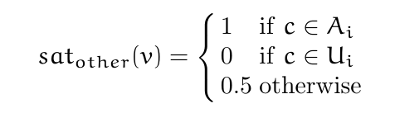
Mental model: COMMUNICATION
Computational model
Mental model
Shared
preferences
Negotiation
Share preferences
I like v
Other’s
preferences
I don’t like v
Share a preference
State Preference(X)
Ask for a preference
Ask Preference(X)
Utterance_{Self}
Utterance_{other}
Notes:
Une option est défini comme le produit cartesien d’un ensemble de criteres

Slide 19
Mental model: COMMUNICATION
Computational model
Mental model
Negotiation
Share preferences
Shared
Proposals
P :Open, T : Accepted, R : Rejeted
Make a proposal
Propose(X)
Reject a proposal
Reject(X)
Accept a proposal
Accept(X)
Share a preference
State Preference(X)
Ask for a preference
Ask Preference(X)
Utterance_{Self}
Utterance_{other}

Slide 20
Negotiation strategy: Behaviors OF DOMINANCE
BEHAVIOURS OF DOMINANCE IN NEGOTIATION
Respecte le code couleurs dans la suite
1
Level of demand and concession (Dedreu et al 95)
Dominance is associated to a high level of demand and a low level of concessions
2
Self vs other (Fiske 93, DeDreu et al 95)
Dominant individuals are self-centered and only interested in satisfying their own preferences.
3
Lead of the negotiation (Dedreu,VanKleef, 04)
Dominant individuals tends to make the first move
Control of the flow of the negotiation

Slide 21
Mental model: Satisfiability (level of demand)
Preferences
Power
1
French
Initial value of dominance : POW ∊ [O,1]
1
0.7
S: Set of satisfiable values
Italian
0.83
Communication
Mexican
Indian
0.66
0.66
Korean
Express the liking of the agent
(StatePreference)
0.33
Chinese
Japanese
0.5
0.16
0
Notes:
Rappel les principes
Ça c’est principe 1
Ils sont plus dominants alors ils aiment moins de choses

Slide 22
Mental model: Satisfiability (level of demand)
Preferences
Power
1
French
Initial value of dominance : POW ∊ [O,1]
1
S: Set of satisfiable values
Italian
0.6
0.83
Communication
Mexican
Indian
0.66
0.66
Korean
Express the liking of the agent
(StatePreference)
0.33
Chinese
Japanese
0.5
0.16
0

Slide 23
Mental model: Satisfiability (level of demand)
Preferences
Power
1
French
Initial value of dominance : POW ∊ [O,1]
1
Values the agent like
Italian
0.6
0.83
Communication
Mexican
Indian
0.66
0.66
Korean
I like French cuisine
I don’t like Korean cuisine
0.33
Values the agent doesn’t like
Chinese
Japanese
0.5
0.16
0

Slide 24
Mental model: acceptability (concession)
Preferences
Power
1
French
Initial value of dominance : POW ∊ [O,1]
1
Italian
0.6
0.83
Communication
Mexican
Indian
0.66
0.66
Korean
Express Proposals
(Propose)
(Accept)
(Reject)
0.33
Chinese
Japanese
0.5
0.16
Notes:
Concession : avant, 1 transparent sans le 2 mais avec à la place un rectangle comme pour sat qui dit « Accep/Reject proposal »

Slide 25
Mental model: acceptability (concession)
Preferences
Power
1
Acceptable
values
French
Initial value of dominance : POW ∊ [O,1]
1
2. Acceptability
Italian
0.6
0.83
Mexican
Indian
Self(pow,t)
0.66
0.66
pow_{a}
τ
Korean
Concessions
pow_{b}
0.33
Chinese
Japanese
0.5
0.16
t
Notes:
Concession : avant, 1 transparent sans le 2 mais avec à la place un rectangle comme pour sat qui dit « Accep/Reject proposal »

Slide 26
Mental model: Decision about proposals (self vs other)
Implementation: Choose the value of a proposal
Take into account self preferences and other preferences
1 - self
self
1 - self
self
High-dominance
Low-dominance

Slide 27


Mental model: utterance choice (lead of dialogue)
Decision rules
Define a priority in the choice of the utterance
Negotiation acts
(Propose, CounterPropose)
Information acts
(AskPreference)
High-dominance
Low-dominance
Notes:
Minable… à revoir…

Slide 28
Mental model: utterance choice
Agent A Dominant
Agent B Submissive
Pow(A) = 0.9, Pow(B) = 0.4
A: "Let's go to a Chinese restaurant." B: "I don't like Chinese restaurants, let's choose something else." A: "Let's go to the Shanghai. It's a quiet, cheap Chinese restaurant on the south side." B: "Do you like Italian restaurants?" A: "I don't like Italian restaurants." B: "Do you like French restaurants?" A: "Let's go to the Shanghai. It's a quiet, cheap Chinese restaurant on the south side."
B: "Do you like French restaurants?"
A: "I don't like French restaurants." B: "Do you like Korean restaurants?" A: "Let's go to a cheap restaurant." B: "Okay, let's go to a cheap restaurant." A: "Let's go to a restaurant on the south side." B: "Okay, let's go to a restaurant on the south side." A: "Let's go to the Shanghai. It's a quiet, cheap Chinese restaurant on the south side." B: "Okay, let's go to the Shanghai restaurant.“

Slide 29
Mental model: utterance choice
Agent A Dominant
Agent B Submissive
Pow(A) = 0.9, Pow(B) = 0.4
Level of demand & concessions
A: "Let's go to a Chinese restaurant." B: "I don't like Chinese restaurants, let's choose something else." A: "Let's go to the Shanghai. It's a quiet, cheap Chinese restaurant on the south side." B: "Do you like Italian restaurants?" A: "I don't like Italian restaurants." B: "Do you like French restaurants?" A: "Let's go to the Shanghai. It's a quiet, cheap Chinese restaurant on the south side."
B: "Do you like French restaurants?"
A: "I don't like French restaurants." B: "Do you like Korean restaurants?" A: "Let's go to a cheap restaurant." B: "Okay, let's go to a cheap restaurant." A: "Let's go to a restaurant on the south side." B: "Okay, let's go to a restaurant on the south side." A: "Let's go to the Shanghai. It's a quiet, cheap Chinese restaurant on the south side." B: "Okay, let's go to the Shanghai restaurant.“

Slide 30
Mental model: utterance choice
Agent A Dominant
Agent B Submissive
Pow(A) = 0.9, Pow(B) = 0.4
self-centeredness
A: "Let's go to a Chinese restaurant." B: "I don't like Chinese restaurants, let's choose something else." A: "Let's go to the Shanghai. It's a quiet, cheap Chinese restaurant on the south side." B: "Do you like Italian restaurants?" A: "I don't like Italian restaurants." B: "Do you like French restaurants?" A: "Let's go to the Shanghai. It's a quiet, cheap Chinese restaurant on the south side."
B: "Do you like French restaurants?"
A: "I don't like French restaurants." B: "Do you like Korean restaurants?" A: "Let's go to a cheap restaurant." B: "Okay, let's go to a cheap restaurant." A: "Let's go to a restaurant on the south side." B: "Okay, let's go to a restaurant on the south side." A: "Let's go to the Shanghai. It's a quiet, cheap Chinese restaurant on the south side." B: "Okay, let's go to the Shanghai restaurant.“
Notes:
PAS DE MANIPULATION

Slide 31
Mental model: utterance choice
Agent A Dominant
Agent B Submissive
Pow(A) = 0.9, Pow(B) = 0.4
Lead of dialogue
A: "Let's go to a Chinese restaurant." B: "I don't like Chinese restaurants, let's choose something else." A: "Let's go to the Shanghai. It's a quiet, cheap Chinese restaurant on the south side." B: "Do you like Italian restaurants?" A: "I don't like Italian restaurants." B: "Do you like French restaurants?" A: "Let's go to the Shanghai. It's a quiet, cheap Chinese restaurant on the south side."
B: "Do you like French restaurants?"
A: "I don't like French restaurants." B: "Do you like Korean restaurants?" A: "Let's go to a cheap restaurant." B: "Okay, let's go to a cheap restaurant." A: "Let's go to a restaurant on the south side." B: "Okay, let's go to a restaurant on the south side." A: "Let's go to the Shanghai. It's a quiet, cheap Chinese restaurant on the south side." B: "Okay, let's go to the Shanghai restaurant.“

Slide 32
Mental model: utterance choice
Agent A Dominant
Agent B Submissive
Pow(A) = 0.9, Pow(B) = 0.4
Lead of dialogue
A: "Let's go to a Chinese restaurant." B: "I don't like Chinese restaurants, let's choose something else." A: "Let's go to the Shanghai. It's a quiet, cheap Chinese restaurant on the south side." B: "Do you like Italian restaurants?" A: "I don't like Italian restaurants." B: "Do you like French restaurants?" A: "Let's go to the Shanghai. It's a quiet, cheap Chinese restaurant on the south side."
B: "Do you like French restaurants?"
A: "I don't like French restaurants." B: "Do you like Korean restaurants?" A: "Let's go to a cheap restaurant." B: "Okay, let's go to a cheap restaurant." A: "Let's go to a restaurant on the south side." B: "Okay, let's go to a restaurant on the south side." A: "Let's go to the Shanghai. It's a quiet, cheap Chinese restaurant on the south side." B: "Okay, let's go to the Shanghai restaurant.“

Slide 33
evaluation: perception of behaviors of dominance

Slide 34
Mental model: agent/agent study
H1
The higher-power agent will more strongly be perceived as self-centered than the lower-power agent
Principe 1
H2
The lower-power agent will be more strongly perceived as making larger concessions than the higher-power agent
H3
The higher-power agent will more strongly be perceived as demanding than the lower-power agent
H4
The higher-power agent will more strongly be perceived as taking the lead in the negotiation than the lower-power agent

Slide 35



Mental model: agent/agent study
procedure
External judges evaluate both agent behaviors during their negotiation.
A between-subject study on the online site CrowdFlower.com.
Fill in a questionnaire about each principle
Agents described as two friends negotiating about restaurant where to have dinner.
Total participants: 120
CONDITIONS
Agent preferences.
Similar preferences
Different preferences
Init of power
Pow(A) = 0.9, Pow(B) = 0.4
Pow(A) = 0.7, Pow(B) = 0.4
Pow(A) = 0.7, Pow(B) = 0.2
4 dialogues generated
Notes:
Changes les couleurs
C’est quoi crowdflower

Slide 36
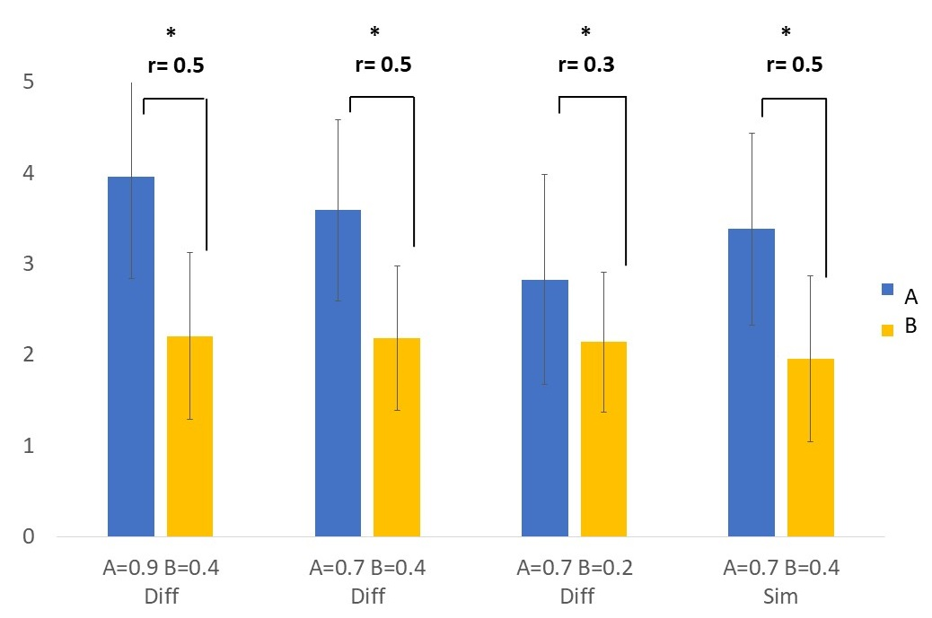
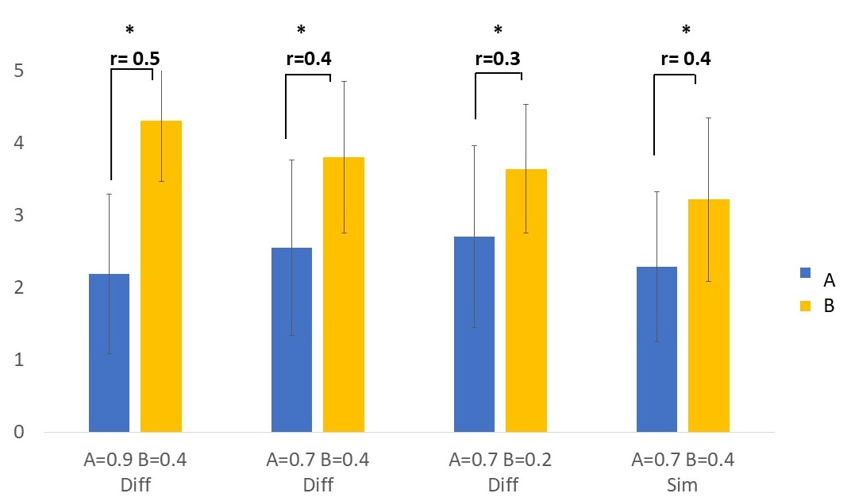
Mental model: agent/agent study
H1: Self centeredness
H2: Concessions
Agent A is more self-centered and makes less concessions.
Agent B tries to find the best trade-off for both parties, and is able to make larger concessions.

Slide 37
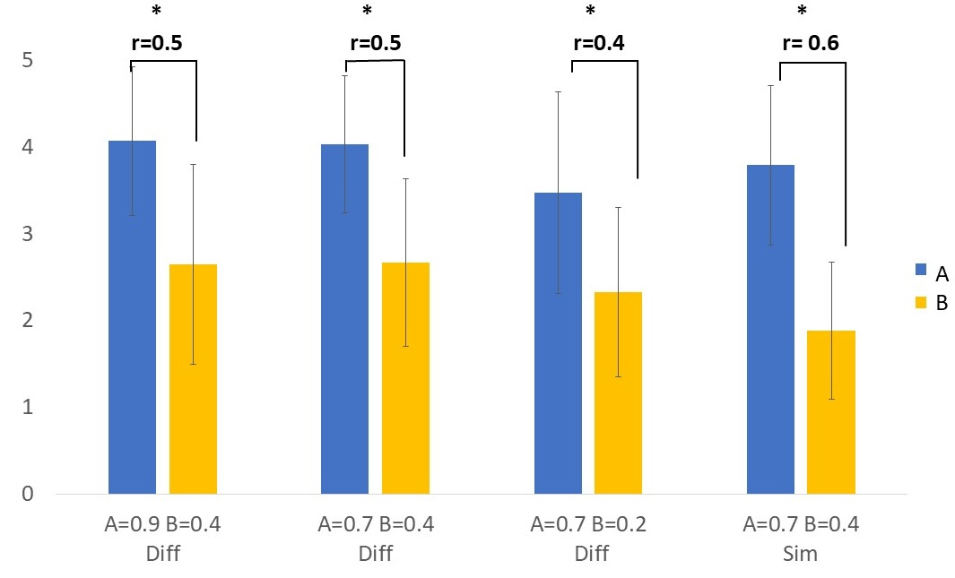
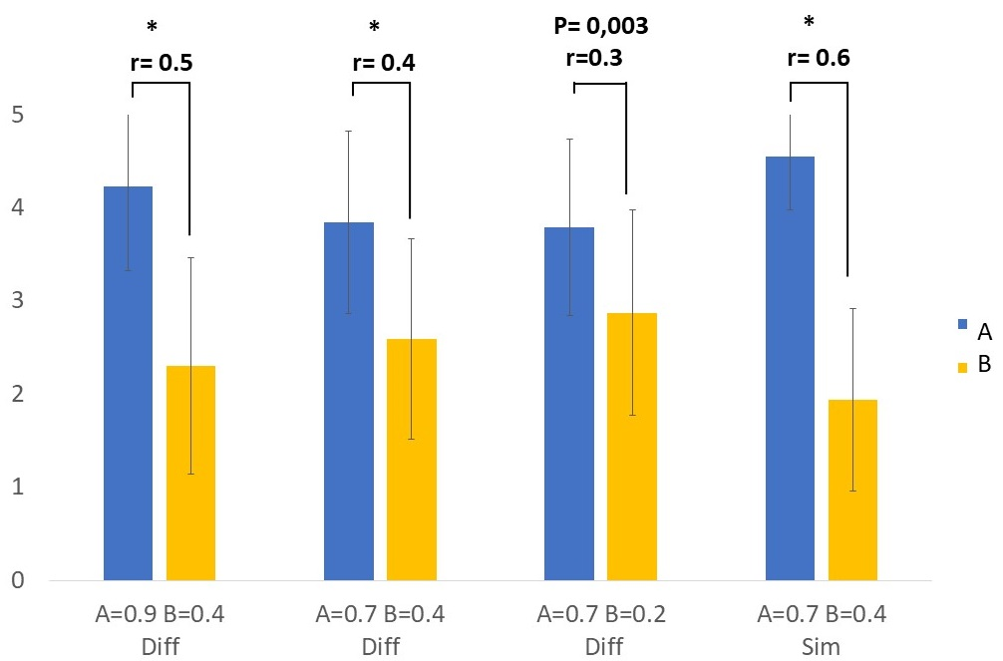
Mental model: agent/agent study
H3: Level of demand
H4: Lead of the dialogue
Agent A is more demanding than agent B.
Agent A is the one who leads the dialogue. (even in the similar condition)

Slide 38

Mental model: agent/agent study
H1
The higher-power agent will more strongly be perceived as self-centered than the lower-power agent
Utt_{Self}
H2
The lower-power agent will be more strongly perceived as making larger concessions than the higher-power agent
Utt_{other}
H3
The higher-power agent will more strongly be perceived as demanding than the lower-power agent
Perception of power’s behaviors in Human/Agent negotiation
H4
The higher-power agent will more strongly be perceived as taking the lead in the negotiation than the lower-power agent

Slide 39
Mental model: agent/human study
procedure
Presentation of the negotiation task: Choose a restaurant using criteria : { Cuisine, Price , Athmosphere, Location}
Total : 420 restaurants
Negotiate with each agent
Fill in a survey
Total participants: 40
CONDITIONS
Init agents
Bob : Dominant behaviors
(Dom =0,8)
Arthur: Submissive behaviors
(Dom =0,4)
Utt_{Self}
Utt_{other}

Slide 40
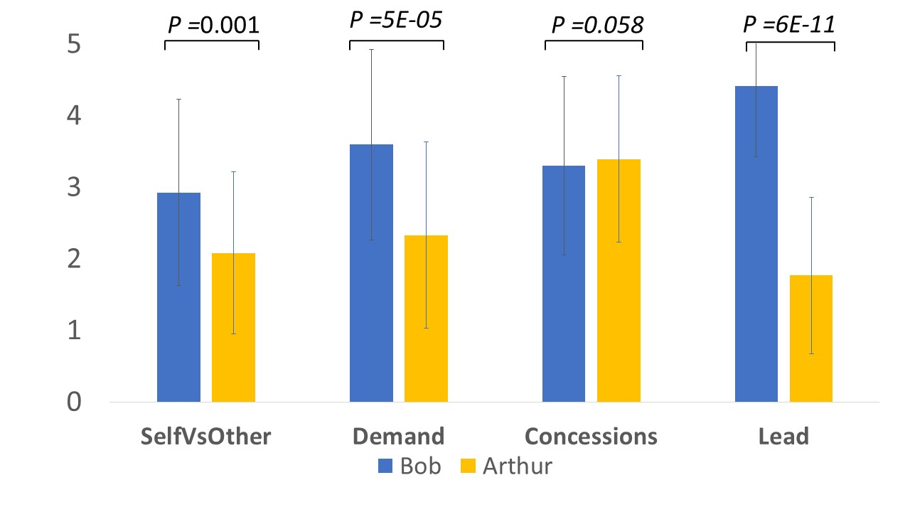
Mental model: agent/human study
Notes:
Ajouter les tailles d’effet et enlever la p-value

Slide 41



Mental model: perception of behaviors of dominance
Behaviors of dominance
Simulation of interpersonal relation
Behaviors of dominance correctly perceived in agent/agent and human/agent interaction
Adapt the behaviors of the agent in order to simulate an interpersonal relation
CAN WE SIMULATE THE USER’S BEHAVIORS USING THE AGENT MENTAL MODEL

Slide 42
transition

Slide 43
OVERVIEW OF THE MODEL OF NEGOTIATION
1
Mental model
Mental model
3
Pow
Pow
Preferences
Pow
Preferences
2
Model of the other
Decisional model
Decisional model
Mental model
Adaptation
Pow
Preferences
Decisional model
Utterance_{Self}
Utterance_{other}

Slide 44

Model of the other: Naïve approach
Pow 1
X
X
Utterance₁
. . .
. . .
SELF
DECISIONAL MODEL
. . .
Possible
pow_{i}
Pow N
X
Utterance_{N}
Revision
Compare
Utterance_{other}
SIMULATION THEORY
Notes:
Concretly, reasoning on the other mental state has the aim to pre

Slide 45
Model of the other: Naïve approach
Pow 1
X
X
Utterance₁
. . .
. . .
SELF
DECISIONAL MODEL
. . .
Possible
pow_{i}
Pow N
X
Utterance_{N}
Revision
COMBINATORY EXPLOSION
Compare
Utterance_{other}
SIMULATION THEORY
Notes:
Concretly, reasoning on the other mental state has the aim to pre

Slide 46

Model of the other: reasoning with uncertainty
1
Total order on preferences
2
For each Pow_{i}
3
Extract hypotheses
French
Set of possible sat values
S = {Jap,It ,Ch, Fr}
S= {Ind, Mex, Kor, Ch}
S ={ Fr, It, Ch, Jap}
. . .
1
Compute nb Sat values
Pow = 0.6
|S| = 4
Italian
Mexican
0.83
Indian
0.66
0.5
Korean
0.33
Chinese
Japanese
0
0.16
5
Revision
4
Adapt decisional model
SIMULATION THEORY
Highest number of accurate hypotheses
Satisfiability
Acceptability
Utterance type

Slide 47
Evaluation: reasoning with uncertainty
1
Goal
Evaluate the accuracy of predictions
Time execution for each prediction
Utt2
Utt1
Submissive
2
Conditions:
Dominant
Initial value of power
Initial preferences
Dominant | 0.3 0.4 0.5
Submissive | 0.6 0.7 0.8 0.9
Domain size | Nb possible hypotheses
Small | 1296
Medium | 4.14 x 10⁵
Large | 2.6 x 10⁹
Total dialogues : 1080

Slide 48
Results: accuracy of predictions
True
Pow
Pow_{other}
1
Accuracy
Root mean square error | 0.12
Residual variation (rv) | 0.015
Comparison
2
Number of dialogue turns to reach a correct prediction
3
Frequency of correct predictions
2130 correct predictions over 2160 predictions
97.4%
Correct prediction | Rv< 0.02 | Best prediction
2.53 | 3.25 | 3.79
Notes:
Mieux expliquer les résultats avec les fonctions
Refaire cette diapo

Slide 49
Model of collaborative negotiation: Simulate an inteprersonal relation of dominance
Notes:
En se basant sur les travaux en psycho, la relation inteprpersonnelle est complémentaire
Cependant, les travaux en négociation se sont intéressés aussi la similarité avait aussi un impact positif

Slide 50

STUDY: COMPLEMENTARITY VS SIMILARITY IN NEGOTIATION
Referencesssss
Increase coordination
Value creation is better
Better common gain
Improve the comfort felt and create mutual liking
People are attracted to partners who express similar behaviors
Increase value creation
Improve attractiveness
COMPLEMENTARITY
SIMILARITY

Slide 51
STUDY: COMPLEMENTARITY VS SIMILARITY IN NEGOTIATION
CONDITIONS
ARTHUR : Similar
INITIAL BEHAVIORS
POW = 0.55
Decision among 630 restaurants
Manipulation of preferences:
Distance(Agent, User) > 0.7
Distance(Agent, Agent_i) > 0.35
Most liked values are different
BOB: Complementary
KEVIN: Neutral

Slide 52
STUDY: COMPLEMENTARITY VS SIMILARITY IN NEGOTIATION
H1
The behaviors of dominance expressed by the agent; whether complementary or similar; are correctly perceived by the participants
H2
Negotiators achieve a greater common gain when negotiators establish a complementary relation of dominance
H3
Negotiation converges more quickly when negotiators establish a complementary relation of dominance
H4
Participants feel more comfortable with a partner who expresses complementary behaviors of dominance
H5
Complementarity in the dominance relation increases appreciation between negotiators

Slide 53

STUDY: COMPLEMENTARITY VS SIMILARITY IN NEGOTIATION
PROCEDURE
Stage 1
Stage 2
Stage 3
Stage 4
Tutorial
Use the interface to know the utterances
Collaborative negotiation with the agent to choose a restaurant
Questionnaire about the negotiation
Information about the preferences
DATA
User preferences
Complete dialogue
User_Pow computed by the ToM at each negotiation turn
Notes:
Pas besoin d’animation pour 3-4 + inscrire en dessous 3 agents (5 mn to 15mn per agent) + nombre de sujets ICI

Slide 54
RESULTS: COMPLEMENTARITY VS SIMILARITY IN NEGOTIATION
Perception of self Dominance Vs other
Notes:
Tailles d’effts

Slide 55

RESULTS : COMPLEMENTARITY VS SIMILARITY IN NEGOTIATION
Perception of self Dominance Vs other

Slide 56
RESULTS : COMPLEMENTARITY VS SIMILARITY IN NEGOTIATION
Perception of self Dominance Vs other
Notes:
Conforme à la théorie Tiender(s), 2003

Slide 57
RESULTS : COMPLEMENTARITY VS SIMILARITY IN NEGOTIATION
Common gain obtained during negotiation
Notes:
Deux graphes un pour fairness et un autre pour satisfaction

Slide 58
RESULTS: COMPLEMENTARITY VS SIMILARITY IN NEGOTIATION
H2 : avec sa couleur Common gain obtained during negotiation
*
*
*

Slide 59
RESULTS : COMPLEMENTARITY VS SIMILARITY IN NEGOTIATION
Convergence of negotiation (number of negotiation turns)
*
*

Slide 60
RESULTS : COMPLEMENTARITY VS SIMILARITY IN NEGOTIATION
Convergence of negotiation (ease of collaboration)
*
*

Slide 61
RESULTS: COMPLEMENTARITY VS SIMILARITY IN NEGOTIATION
Comfort felt during negotiation
*
*
*
Notes:
Refaire le test
Dire que la taille d’effet est moyenne

Slide 62
RESULTS: COMPLEMENTARITY VS SIMILARITY IN NEGOTIATION
Appreciation of the negotiator’s agent
*
*
*

Slide 63
RESULTS: COMPLEMENTARITY VS SIMILARITY IN NEGOTIATION
1
2
3
4
5
Behaviors of dominance
Common gain
Rapidity of convergence
Comfort during negotiation
Appreciation of the agent
No difference in perception
Significative higher common gain with Complementary agent
Demand, concession, self centeredness
Lead of negotiation
Efficient exchange of information with the complementary agent
Easer collaboration
Participants felt significatively more comfortable while negotiating with complementary agent
Participants appreciate significatively more the negotiation with complementary agent

Slide 64
Transition Conclusion

Slide 65
Conclusion: MODEL OF NEGOTIATION based on dominance
Validation
Agent/agent
Human/agent
Validation
Human/agent
1
Mental model
Mental model
3
Pow
Pow
Preferences
Pow
Preferences
2
Model of the other
Decisional model
Decisional model
Mental model
Complementary
Relation
Pow
Preferences
Decisional model
Communication
Utterance_{Self}
Utterance_{other}
Notes:
Pow = avec le 3 + changement couleur + attention flèche seule au début (en 1)

Slide 66
perspective: what’s next ?
Non verbal behaviors
Integrate non verbal behaviors to improve expressivity
Study the relation of non verbal behaviors and perception of negotiation strategies
Social conversational agent
Argumentation in negotiation
Verbal expressivity
Influence of interpersonal dominance on argumentation's strategies
Linguistic style
Natural language in interaction
Evaluation on repeated interactions
Integrate individual traits
Create specific topics of negotiation
Study personality traits and social hierarchy

Slide 67
Lydia.ouldouali@gmail.com
Notes:
Publications au fur et a mesures des résultats
Mes encadrements

